Slide 1


Suraj Singh
26/02/2025

Slide 2

Outline
Executive Summary
Introduction
Methodology
Results
Conclusion
Appendix

Slide 3
Executive Summary
Summary of methodologies
Summary of all results

Slide 4
Introduction
Project Background and Context:
The commercial space industry is rapidly evolving, with companies like SpaceX, Blue Origin, and Virgin Galactic making space travel more accessible. Among them, SpaceX stands out for its cost-effective rocket launches, primarily due to its ability to reuse the first stage of the Falcon 9 rocket. This innovation significantly reduces launch costs compared to competitors.
Problems We Want to Solve:
Can we predict whether the first stage of a Falcon 9 launch will successfully land?
How does first-stage reusability impact the overall cost of a rocket launch?
Can machine learning help analyze launch data to make cost predictions without relying on complex rocket science?
By leveraging public data and machine learning, our goal is to build a predictive model that helps estimate launch costs and first-stage reusability, providing key insights for a new competitor, Space Y.

Slide 5

Section 1

Slide 6
Methodology
Executive Summary
Data collection methodology: We are using SpaceX API and Web Scraping for the data collection
Perform data wrangling
Perform Action to deal with Missing Values
Perform exploratory data analysis (EDA) using visualization and SQL
Perform interactive visual analytics using Folium and Plotly Dash
Perform predictive analysis using classification models
Build different classification model using different algorithms with Tuning and Last Evaluate all the model and select best performing model

Slide 7
Data Collection
How Data Was Collected
Primary Source: SpaceX REST API (api.spacexdata.com/v4/launches/past)
Collected data on rocket specifications, payload, launch & landing details
Used requests library to retrieve API data
Converted JSON response into a structured DataFrame using json_normalize
Additional Source: Web Scraping
Extracted Falcon 9 launch records from Wikipedia using BeautifulSoup
Parsed HTML tables and converted data into Pandas DataFrame

Slide 8
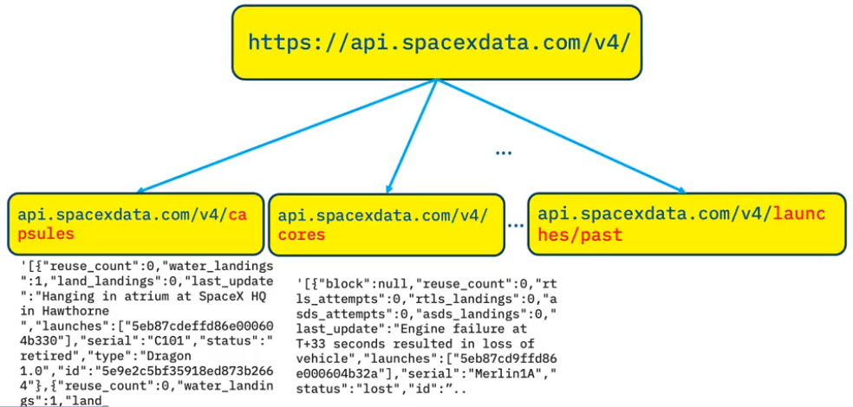
Data Collection – SpaceX API
We used the SpaceX REST API to collect historical launch data, including:
Primary API Endpoint:
GET api.spacexdata.com/v4/launches/past → Retrieves past launch data in JSON format
Used requests.get(url).json() to extract data
Additional API Calls for Data Enrichment:
GET api.spacexdata.com/v4/rockets/{id} → Retrieves rocket details
GET api.spacexdata.com/v4/cores/{id} → Retrieves booster details
GET api.spacexdata.com/v4/payloads/{id} → Retrieves payload information
GET api.spacexdata.com/v4/launchpads/{id} → Retrieves launch site details
Git URL : https://github.com/Sunny1084/IBMDS/blob/main/jupyter-labs-spacex-data-collection-api.ipynb
Place your flowchart of SpaceX API calls here

Slide 9
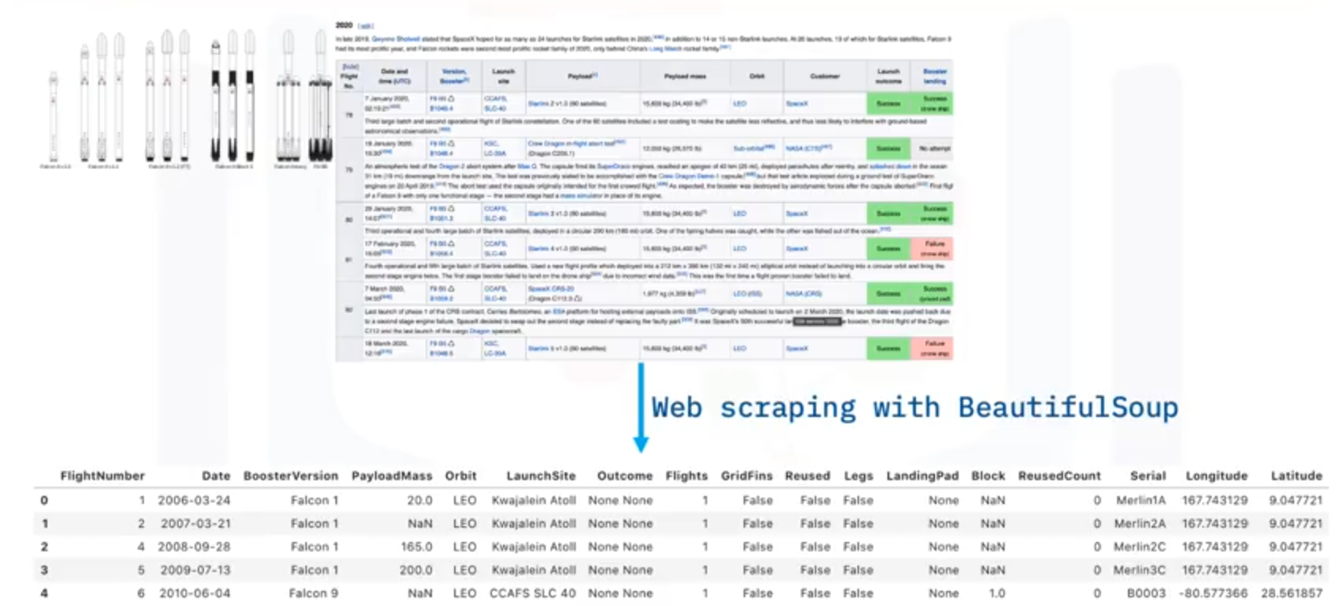
Data Collection - Scraping
Key Steps in Web Scraping Falcon 9 Launch Data
Data Source: Wikipedia Falcon 9 launch records
Library Used: BeautifulSoup for HTML parsing
Process:
Retrieve HTML Data
Use requests.get(wiki_url) to fetch the webpage
Parse HTML Tables
Load HTML into BeautifulSoup and locate <table> tags
Extract Relevant Data
Identify table headers & extract launch details
Convert to DataFrame
Use Pandas to store the cleaned data
Git URL : https://github.com/Sunny1084/IBMDS/blob/main/jupyter-labs-webscraping%20(1).ipynb
Place your flowchart of web scraping here

Slide 10
Data Wrangling
How Data Were Processed
Feature Selection:
Extracted relevant attributes: Flight Number, Date, Booster Version, Payload Mass, Orbit, Launch Site, Outcome, Grid Fins, Reused, Legs, Landing Pad, Reused Count, Serial, Coordinates
Data Cleaning & Transformation:
Launch Site Standardization → Categorical values (e.g., Kennedy Space Center, Vandenberg AFB)
Orbit Classification → LEO, GTO, etc.
Outcome Encoding:
Converted landing outcomes into a binary classification (0 = Failure, 1 = Success)
Example:
"True ASDS" → 1 (Successful landing on drone ship)
"False ASDS" → 0 (Unsuccessful landing)
GitHub URL : https://github.com/Sunny1084/IBMDS/blob/main/labs-jupyter-spacex-Data%20wrangling.ipynb

Slide 11
EDA with Data Visualization
Charts Used & Their Purpose
Success Rate Over Time:
Chart Type: Line Chart
Purpose: Shows how the Falcon 9 first-stage landing success rate has improved since 2013.
Launch Site vs. Success Rate:
Chart Type: Bar Chart
Purpose: Displays success rates for different launch sites:
CCAFS LC-40 → 60%
KSC LC-39A & VAFB SLC 4E → 77%
Helps determine if launch location influences landing success.
Payload Mass vs. Landing Outcome:
Chart Type: Scatter Plot with Color Overlay
Purpose:
Identifies payload mass influence on landing success.
Shows that CCAFS LC-40 has 100% success if payload > 10,000 kg.
Feature Correlation Heatmap:
Chart Type: Heatmap
Purpose: Identifies which features are correlated with successful landings.
Github URL : https://github.com/Sunny1084/IBMDS/blob/main/edadataviz.ipynb

Slide 12
EDA with SQL
SQL Queries Performed
🔹 Launch Site Analysis:
Retrieved unique launch site names.
Displayed 5 records where launch sites begin with "CCA".
🔹 Payload Mass Insights:
Calculated the total payload mass for missions launched by NASA (CRS).
Computed the average payload mass for booster version F9 v1.1.
🔹 Landing Outcomes & Booster Performance:
Identified the first successful ground pad landing date.
Listed boosters that landed successfully on a drone ship with payload mass between 4000 and 6000 kg.
Counted the total number of successful and failed mission outcomes.
🔹 Booster Performance Analysis:
Identified booster versions that carried the maximum payload mass using a subquery.
Filtered records for 2015 showing failure landing outcomes on a drone ship, with booster versions and launch sites.
Ranked landing outcomes (success/failure) between 2010-06-04 and 2017-03-20 in descending order.
Github Link : https://github.com/Sunny1084/IBMDS/blob/main/jupyter-labs-eda-sql-coursera_sqllite%20(1).ipynb

Slide 13
Build an Interactive Map with Folium
Map Objects Added & Their Purpose
Launch Site Markers
Used: folium.Marker
Purpose: Mark each SpaceX launch site on the map.
Customization: Used DivIcon to display the site name.
Launch Site Circles
Used: folium.Circle
Purpose: Highlight the area surrounding each launch site with a 1000m radius for better visibility.
Success-Based Marker Colors
Created Column: marker_color in spacex_df.
Purpose:
Green markers → Successful launches
Red markers → Failed launches
Helps visualize which sites have high success rates.
Coastline Distance Measurement
Marked the closest coastline point using MousePosition.
Purpose: Calculate the distance between launch sites and the coastline for safety analysis.
Connections to Nearby Infrastructure
Drew lines from launch sites to:
Nearest railway (for transport accessibility).
Closest highway (for logistics and supply chain).
Nearest city (for workforce and support facilities).
Purpose: Understand how launch sites are connected to essential infrastructure.
Github URL : https://github.com/Sunny1084/IBMDS/blob/main/lab_jupyter_launch_site_location.ipynb

Slide 14
Build a Dashboard with Plotly Dash
Plots & Interactions Added to the Dashboard
1. Launch Success Pie Chart
Plot Type: Pie Chart (px.pie())
Interaction: Updates based on the selected Launch Site from the dropdown.
Purpose:
Shows the overall success rate of launches.
Helps compare success vs. failure for each individual launch site.
2. Payload vs. Success Scatter Plot
Plot Type: Scatter Plot (px.scatter())
Interaction:
Filters based on Launch Site selection (Dropdown).
Filters based on Payload Mass range (Range Slider).
Purpose:
Identifies how Payload Mass affects launch success.
Highlights trends across different booster versions.
Why These Plots & Interactions?
Dropdown Menu (Launch Site Selection)
Enables site-specific analysis of launch success.
Range Slider (Payload Selection)
Allows users to explore payload impact on launch success dynamically.
Interactive & Real-time Updates
Enhances exploratory analysis with user-controlled filtering.
Github Link : https://github.com/Sunny1084/IBMDS/blob/main/dash_interactivity.py

Slide 15
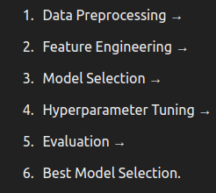
Predictive Analysis (Classification)
Model Development Process
Data Preparation: Preprocessed launch data, handled missing values, and transformed categorical variables using one-hot encoding.
Feature Selection: Selected key attributes such as payload mass, launch site, booster version, and orbit type for prediction.
Model Training & Evaluation:
Logistic Regression: Used as a baseline model for binary classification.
Support Vector Machine (SVM): Applied to improve classification performance.
Decision Tree: Evaluated for interpretability and feature importance.
K-Nearest Neighbors (KNN): Explored for non-linear decision boundaries.
Random Forest: Used as an ensemble model to improve prediction accuracy.
Hyperparameter Tuning: Grid search and cross-validation applied to optimize models.
Performance Metrics: Models evaluated using accuracy, precision, recall, and F1-score.
Best Performing Model: Logistics Regression, SVM and KNN have equal accuracy. So for now we can take LR model.

Slide 16
Results
Exploratory data analysis results
Interactive analytics demo in screenshots
Predictive analysis results

Slide 17

Section 2

Slide 18
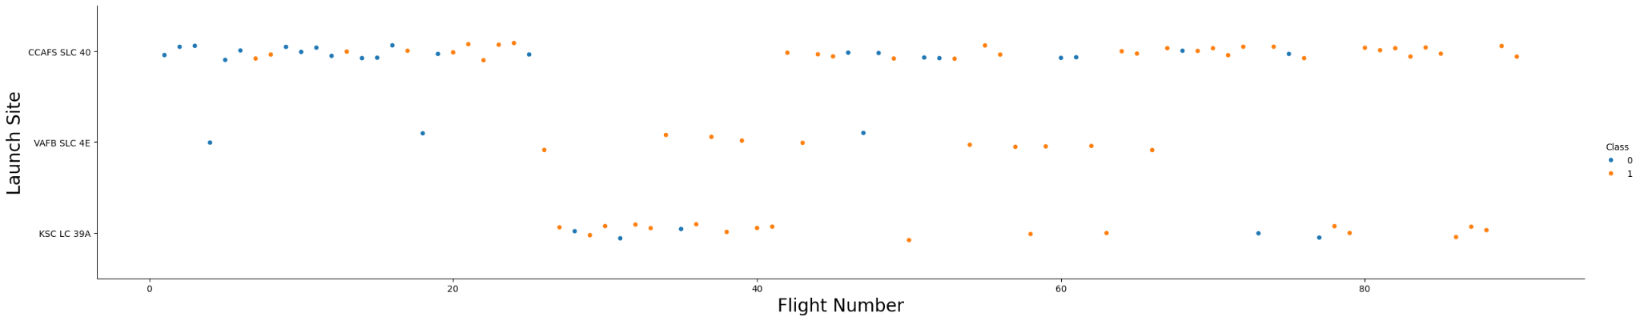
Flight Number vs. Launch Site
The plot shows the relationship between flight numbers and launch sites, with color-coded points indicating the success (1) or failure (0) of each mission. The success rate varies across launch sites, with CCAFS SLC-40 showing a mix of outcomes, while KSC LC-39A and VAFB SLC-4E appear to have higher success rates in later flights.
4o

Slide 19
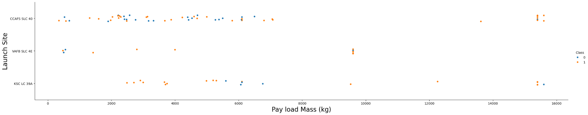
Payload vs. Launch Site
The plot shows the relationship between payload mass and landing success across different launch sites, with successful landings (orange) more frequent at higher payloads. Notably, payloads above 10,000 kg have a higher success rate, indicating a possible correlation between heavier payloads and successful landings.

Slide 20
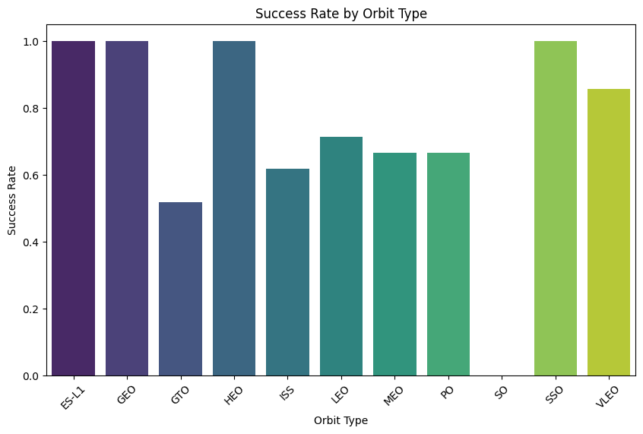
Success Rate vs. Orbit Type
The plot shows the success rate of launches based on orbit type, with ES-L1, GEO, HEO, and SSO achieving a 100% success rate. GTO has the lowest success rate, indicating possible challenges in reaching this orbit compared to others.

Slide 21
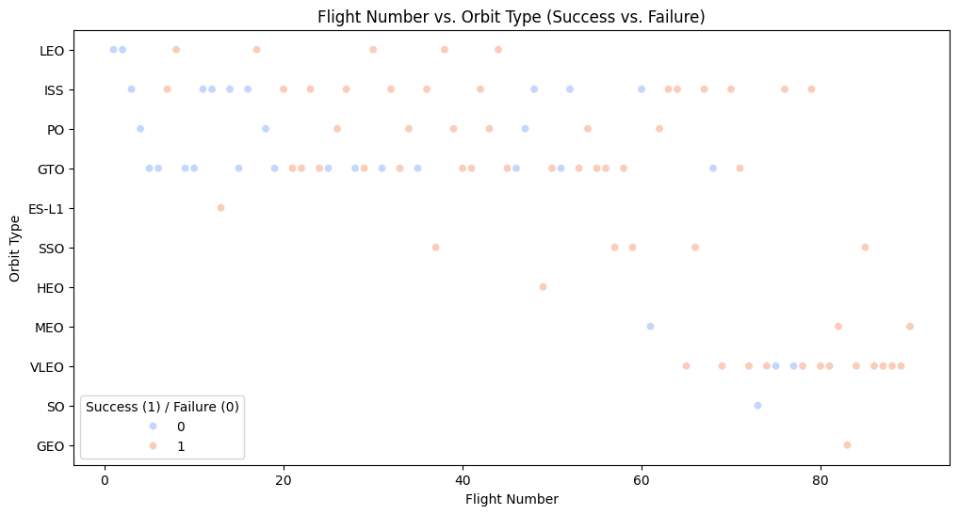
Flight Number vs. Orbit Type
The plot visualizes flight success and failure across different orbit types, showing that earlier flights had a mix of successes and failures, while later flights generally improved in success rates. GTO and MEO orbits appear to have more failures compared to other orbit types.

Slide 22
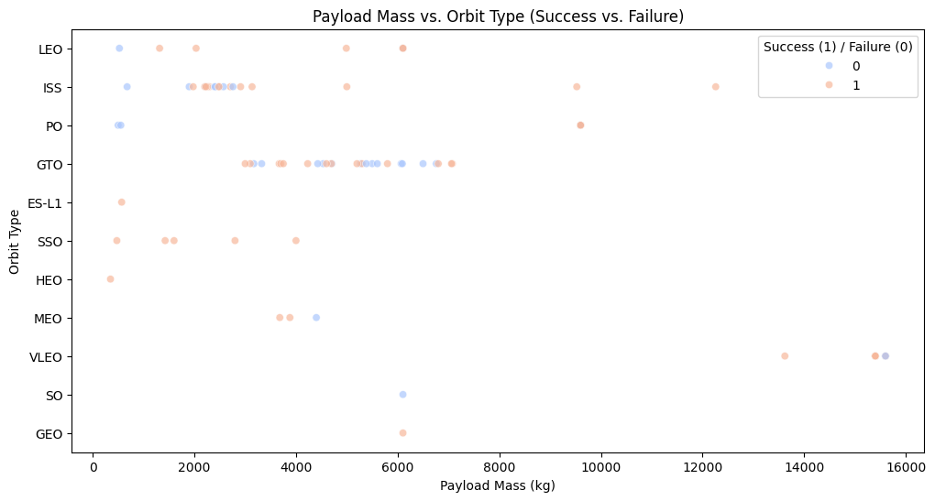
Payload vs. Orbit Type
The plot shows the relationship between payload mass and orbit type, highlighting that lower payloads have a mix of successes and failures, whereas heavier payloads generally have fewer successful launches. GTO orbits exhibit a higher failure rate compared to other orbit types.

Slide 23
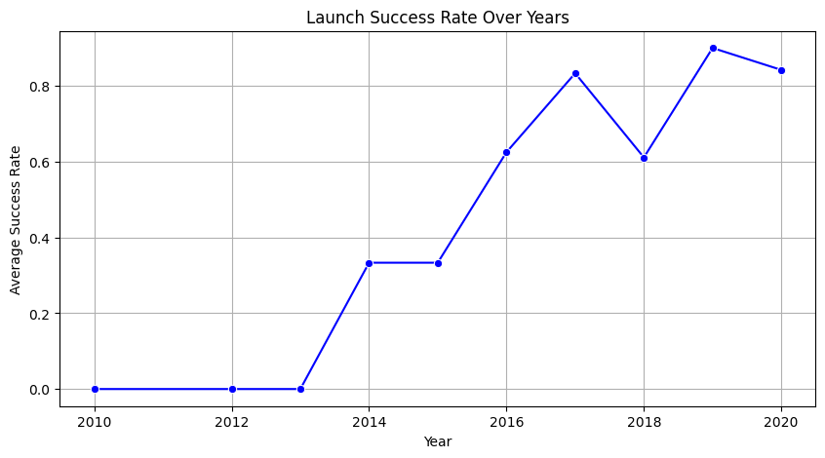
Launch Success Yearly Trend
The plot shows a significant improvement in launch success rates over the years, starting from 2013 and peaking around 2019. Despite minor fluctuations, the overall trend indicates continuous advancements in launch reliability.

Slide 24
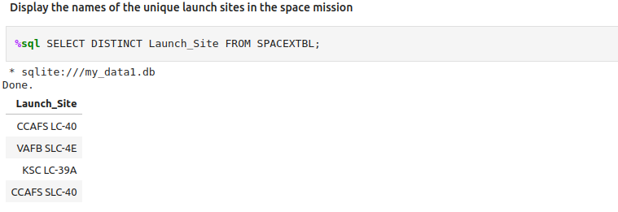
All Launch Site Names
The names of the unique launch sites
The SQL query retrieves distinct launch site names from the SPACEXTBL table, ensuring no duplicates appear in the output.

Slide 25
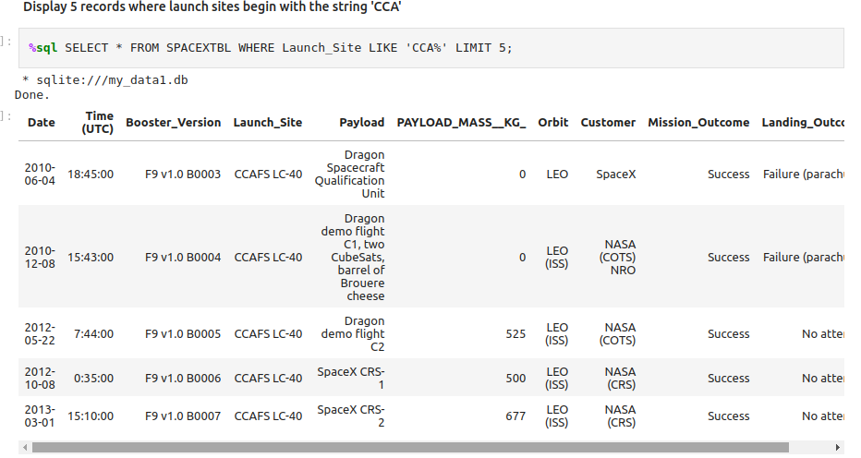
Launch Site Names Begin with 'CCA'
Five records where launch sites begin with `CCA`
The SQL query retrieves five records from the SPACEXTBL table where the Launch_Site starts with "CCA". The result includes launch details such as date, booster version, payload, payload mass, orbit, customer, mission outcome, and landing outcome

Slide 26
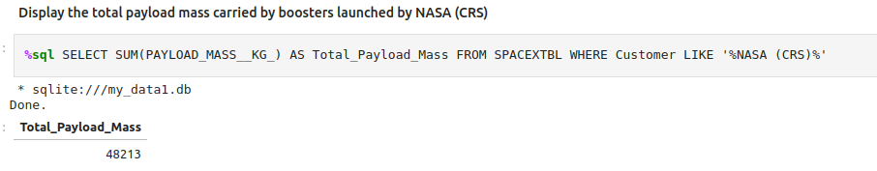
Total Payload Mass
The total payload carried by boosters from NASA
The SQL query calculates the total payload mass carried by boosters launched for NASA (CRS) missions. The result shows that the total payload mass transported in these missions is 48,213 kg.

Slide 27
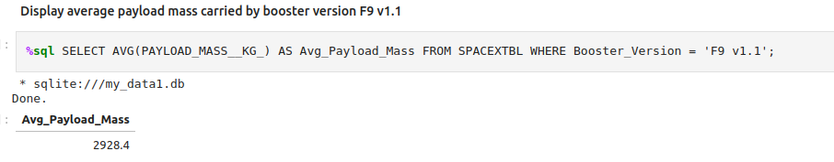
Average Payload Mass by F9 v1.1
The average payload mass carried by booster version F9 v1.1
Present your query result with a short explanation here
The SQL query calculates the average payload mass carried by the booster version F9 v1.1. The result shows that the average payload mass for this booster version is 2928.4 kg.

Slide 28
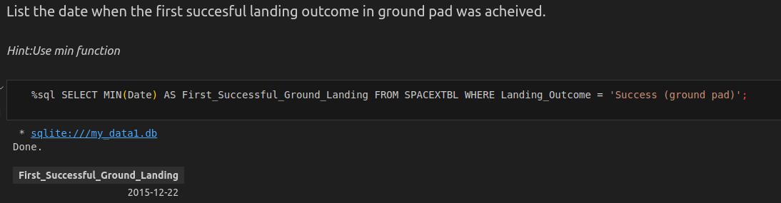
First Successful Ground Landing Date
The dates of the first successful landing outcome on ground pad
The SQL query retrieves the earliest date when a successful landing on a ground pad was achieved. The result indicates that the first successful ground landing occurred on December 22, 2015.

Slide 29
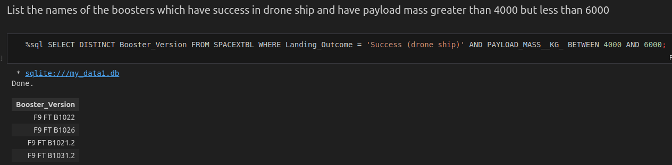
Successful Drone Ship Landing with Payload between 4000 and 6000
The names of boosters which have successfully landed on drone ship and had payload mass greater than 4000 but less than 6000
The SQL query retrieves the names of boosters that successfully landed on a drone ship and carried a payload mass between 4000 kg and 6000 kg. The result lists four distinct booster versions

Slide 30
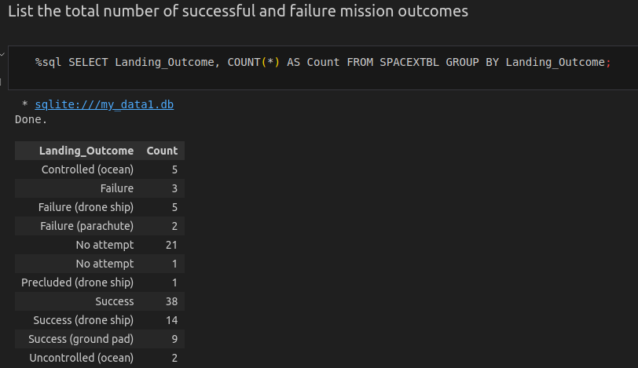
Total Number of Successful and Failure Mission Outcomes
The total number of successful and failure mission outcomes
The query retrieves the count of different landing outcomes from the SPACEXTBL dataset. The results categorize landings into successful and failed attempts

Slide 31
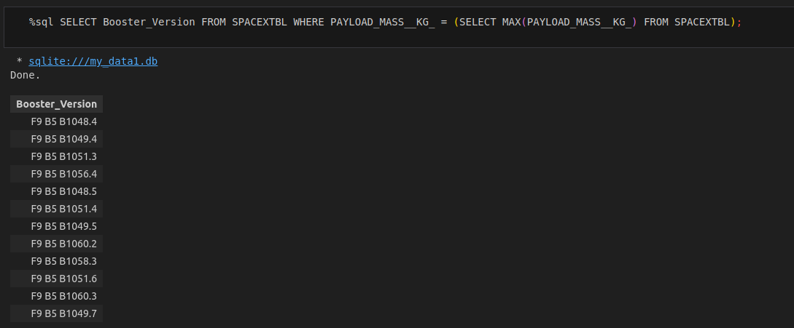
Boosters Carried Maximum Payload
The names of the booster which have carried the maximum payload mass
The query retrieves the Booster Versions that carried the maximum payload mass recorded in the SPACEXTBL dataset. By using a subquery, it selects all booster versions where the PAYLOAD_MASS__KG_ matches the highest payload mass in the dataset.

Slide 32
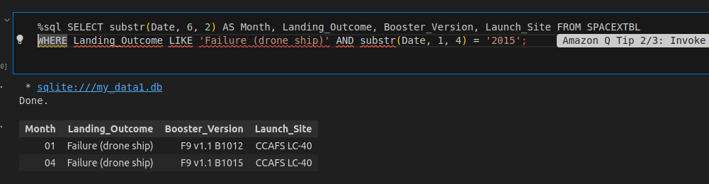
2015 Launch Records
The failed landing_outcomes in drone ship, their booster versions, and launch site names for in year 2015
The query retrieves information about drone ship landing failures that occurred in the year 2015. It extracts the month from the date, along with the landing outcome, booster version, and launch site.

Slide 33
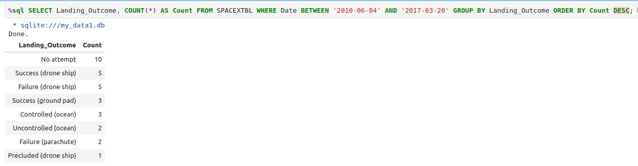
Rank Landing Outcomes Between 2010-06-04 and 2017-03-20
The count of landing outcomes (such as Failure (drone ship) or Success (ground pad)) between the date 2010-06-04 and 2017-03-20, in descending order
The query retrieves the count of different landing outcomes for SpaceX missions between June 4, 2010, and March 20, 2017. The results are grouped by Landing_Outcome and sorted in descending order of count.

Slide 34

Section 3

Slide 35
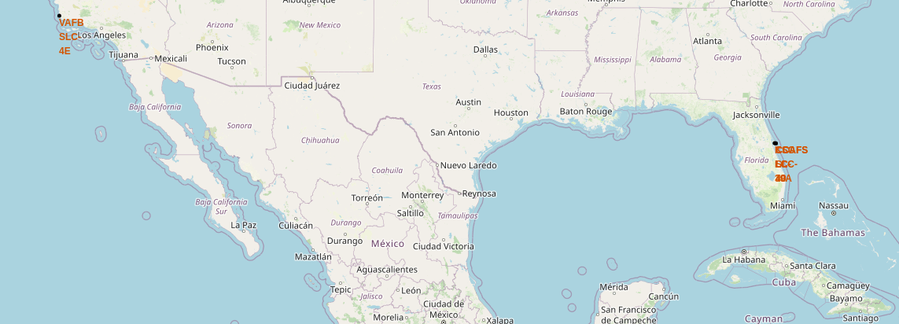
All Launched Sites
East Coast launch sites (Florida) are used for missions requiring equatorial orbits, such as ISS resupply missions.
West Coast launch sites (California) are used for polar and sun-synchronous orbits, typically for Earth observation and reconnaissance satellites.
This visualization highlights SpaceX's strategic use of multiple launch sites for different types of missions.

Slide 36
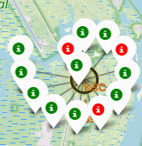
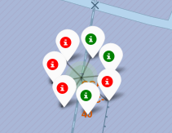
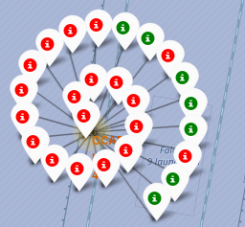
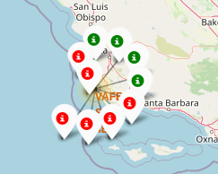
Launch Outcomes Each Site
These images display SpaceX launch outcomes across different launch sites, with green markers indicating successful launches and red markers representing failures. Key observations include:
Vandenberg (VAFB) Site: A mix of successes and failures, with a significant number of red markers.
Cape Canaveral (CCAFS) Site: Shows a high number of launches, with a noticeable failure rate.
Another Ocean Recovery Site: Similar pattern, indicating challenges with drone ship landings.
Kennedy Space Center (KSC): Primarily successful landings, highlighting a better success rate.

Slide 37
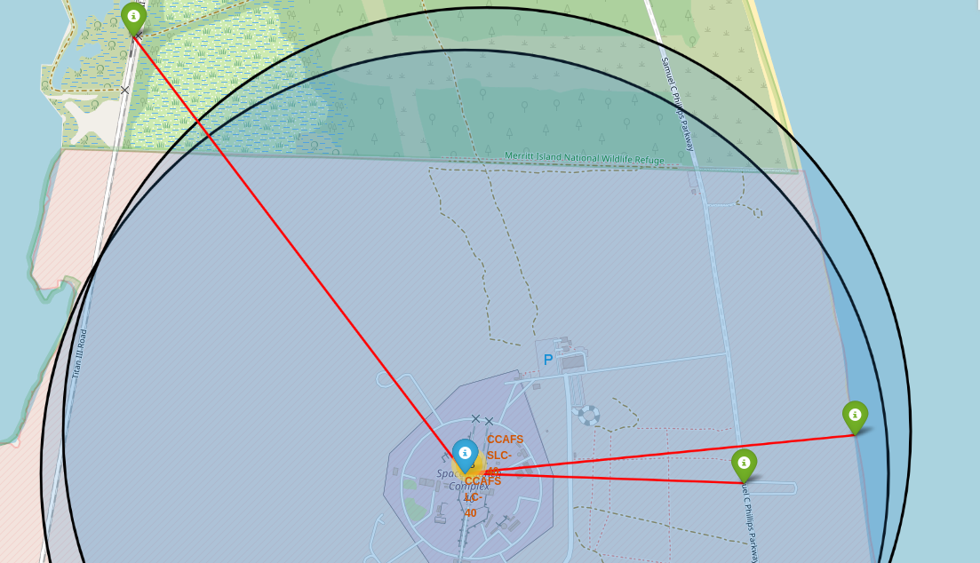
Launch Sites to its Proximities
This map highlights the Cape Canaveral Air Force Station (CCAFS) launch site and its proximities. Key observations include:
Proximity to Transportation Routes: The map shows a railway line (left) and roadways (right), indicating accessible logistics for transporting rocket components.
Coastal Location: The site is near the coastline, essential for safety, as failed launches or debris fall into the ocean.
Marked Landing Zones: Green markers with red connecting lines likely represent landing or monitoring stations, showing the spatial relationship between launch pads and recovery sites.
Safety and Environmental Considerations: The shaded areas and concentric circles may indicate exclusion zones or impact areas, ensuring public safety and environmental protection.
Overall, this visualization helps assess logistics, safety measures, and launch impact zones around CCAFS.

Slide 38

Section 4

Slide 39
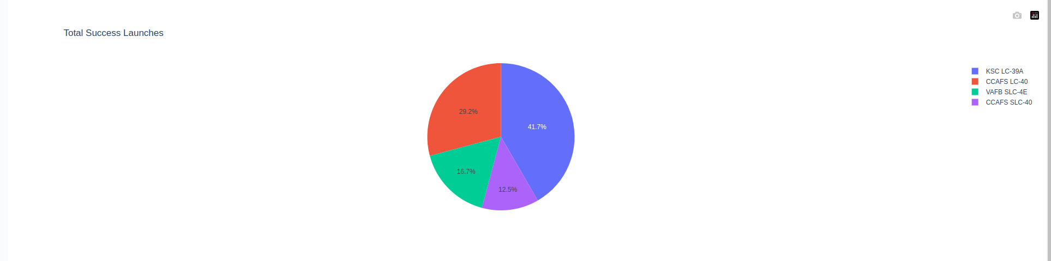
Launch Success Counts for all Sites
This pie chart represents the total successful launches from different launch sites. Key observations include:
KSC LC-39A Leads (41.7%): Kennedy Space Center's Launch Complex 39A has the highest success rate, making it a primary launch site.
CCAFS LC-40 (29.2%): Cape Canaveral's Launch Complex 40 is the second most utilized, playing a crucial role in successful missions.
VAFB SLC-4E (16.7%): Vandenberg Air Force Base's pad has a moderate contribution, mainly used for polar orbits.
Duplicate Entry for CCAFS LC-40 (12.5%)?: There seems to be a duplicate entry for CCAFS LC-40, which might need data cleaning.
Overall, the chart shows KSC LC-39A as the dominant launch site, with CCAFS LC-40 and VAFB SLC-4E playing key roles in mission successes.

Slide 40
Piechart for the launch site
KSC LC-39A Leads (41.7%): Kennedy Space Center's Launch Complex 39A has the highest success rate, making it a primary launch site.

Slide 41
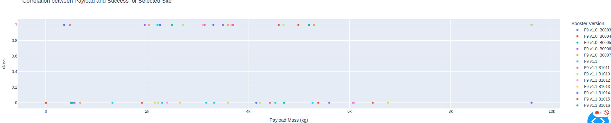
Scatter Plot Payload vs Lanuch Outcome
This scatter plot visualizes the correlation between payload mass and launch success for different booster versions
Heavier payloads (~4,000 - 10,000 kg) tend to have higher success rates.
Newer boosters (Block 5) perform better than earlier versions.
Lower payloads (~0 - 4,000 kg) have a mix of successes and failures.

Slide 42

Section 5

Slide 43
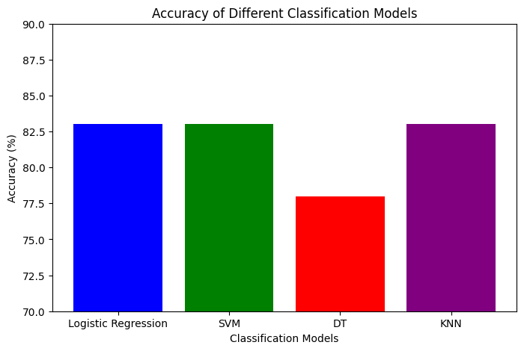
Classification Accuracy
Logistic Regression, SVM, and KNN all achieved 83% accuracy, making them the top-performing models.
Decision Tree (DT) had the lowest accuracy at 78%, indicating it may not generalize as well.
Since Logistic Regression, SVM, and KNN have the same accuracy, the best model depends on efficiency and interpretability:
Logistic Regression is simple, interpretable, and performs well on linearly separable data.
SVM is powerful for small to medium-sized datasets but can be computationally expensive.
KNN is easy to implement but can be slow for large datasets due to distance calculations.

Slide 44

Confusion Matrix
The confusion matrix of the best performing model with an explanation

Slide 45
Conclusions
Top Performers: Logistic Regression, SVM, and KNN achieved the highest accuracy (83%), making them suitable candidates for deployment.
Lowest Accuracy: The Decision Tree model had the lowest accuracy (78%), suggesting it may not generalize well.
Model Selection:
Logistic Regression is the best choice for efficiency and interpretability.
SVM is effective for complex patterns but computationally expensive.
KNN is easy to implement but slow for large datasets.
Deployment Recommendation: Logistic Regression is the most practical choice for real-world applications due to its speed and ease of interpretation.
Further Optimization: Hyperparameter tuning and feature engineering could further improve model accuracy before final deployment.

Slide 46
Appendix
Include any relevant assets like Python code snippets, SQL queries, charts, Notebook outputs, or data sets that you may have created during this project

Slide 47


